Slide 1

HTTP 3
Dima Ionut Daniel

Slide 2
Contents
What is HTTP/3?
History
Goals
HTTP 3 features
Concepts
Core
HTTP/2 vs HTTP/3
Conclusions
Bibliography

Slide 3

What is HTTP/3?
HTTP/3 is the third major version of the Hypertext Transfer Protocol used to exchange information on the World Wide Web.
HTTP/3 uses QUIC, a multiplexed transport protocol built on UDP
HTTP/3 specification was published on 6 June 2022, as a Proposed Standard in RFC 9114.

Slide 4
History
HTTP/3 originates from an Internet Draft adopted by the QUIC working group.
The original proposal was named "HTTP/2 Semantics Using The QUIC Transport Protocol", and later renamed "Hypertext Transfer Protocol (HTTP) over QUIC".
Support for HTTP/3 was added to Chrome (Canary build) in September 2019 and then eventually reached stable builds but was disabled by a feature flag. It was enabled by default in April 2020.
Firefox added support for HTTP/3 in November 2019 through a feature flag and started enabling it by default in April 2021 in Firefox 88.

Slide 5
Goals
Stream Multiplexing
Header Compression
Server Push and Prioritization
Fewer Handshakes, Faster Connection
Session Resumption/0-RTT
Seamless Connection Migration with CID

Slide 6
HTTP 3 features
QUIC runs over UDP—a connectionless, lightweight protocol. QUIC benefits:
QUIC is connectionless and enables multiplexing at the transport layer, preventing TCP’s head-of-line blocking issue.
Since UDP does not require a client-server connection, it facilitates data delivery via the most optimal routes.
This approach has no data retransmission mechanism, so it usually causes packet loss.
QUIC addresses this via multiplexed connections at the higher level (to enable the transmission of multiple data streams simultaneously and independently) and prevent packet losses in one stream from affecting others.

Slide 7
HTTP 3 features (cont.)
QUIC offers bandwidth estimation from both server and client directions, to determine how much data a network can transmit within a given session, and forward error correction (FEC) capabilities (via FEC packets) to prevent errors in unstable network environments, further enhancing performance.

Slide 8
Concepts
QUIC: Quick UDP Internet Connection
Endpoint: an entity (client or server) that can participate in a QUIC connection by generating, receiving, and processing QUIC packets.
Client: the endpoint that initiates a QUIC connection.
Server: the endpoint that accepts a QUIC connection.
QUIC packet: a complete processable unit of QUIC that can be encapsulated in a UDP datagram.
Ack-eliciting packet: a QUIC packet that contains frames other than ACK, PADDING, and CONNECTION_CLOSE.

Slide 9
Concepts (cont.)
Frame: a unit of structured protocol information; there are multiple frame types, each of which carries different information. Frames are contained in QUIC packets.
Connection ID: an identifier that is used to identify a QUIC connection at an endpoint.
Stream: a unidirectional or bidirectional channel of ordered bytes within a QUIC connection. A QUIC connection can carry multiple simultaneous streams.
Application: an entity that uses QUIC to send and receive data.

Slide 10
Core
HTTP/3 uses similar semantics compared to earlier revisions of the protocol, including the same request methods, status codes, and message fields, but encodes them and maintains session state differently. HTTP/3 has lower latency and loads more quickly in real-world usage when compared with previous versions: in some cases, over four times as fast than with HTTP/1.1.
HTTP/3 is (at least partially) supported by 97% of tracked web browser installations (thereof of 98% of "tracked mobile" web browsers), and 29% of the top 10 million websites.

Slide 11
Core (cont.)
HTTP/3 establishes efficient connections and reduces latency by reducing the number of handshakes required to establish a connection.
In HTTP/2, establishing a connection involves a series of handshakes between the client and server.
These handshakes introduce additional round trips, increasing the latency of establishing a connection.

Slide 12
Core (cont.)
The connection ID (CID) feature in HTTP/3 eases migration whenever a client switches networks or devices.
Thanks to the CID feature, clients can maintain a stable connection without requiring new handshakes.
CID works by assigning a unique identifier to each connection, and when the client switches networks or devices, it simply updates the network information associated with the connection while keeping the same CID.

Slide 13
Core (cont.)
QUIC is a connection-oriented protocol that creates a stateful interaction between a client and server.
QUIC integrates the TLS handshake, although using a customized framing for protecting packets.
QUIC packets are carried in UDP datagrams to better facilitate deployment in existing systems and networks.
Application protocols exchange information over a QUIC connection via streams, which are ordered sequences of bytes.
2 types of streams can be created: unidirectional and bidirectional streams.

Slide 14
Core (cont.)
Streams in QUIC provide a lightweight, ordered byte-stream abstraction to an application.
Streams can be unidirectional or bidirectional.
Streams can be created by sending data.
Streams are identified within a connection by a numeric value, called stream ID.
A QUIC endpoint MUST NOT reuse a stream ID within a connection.

Slide 15
Core (cont.)
The two least significant bits from a stream ID therefore identify a stream as one of four types.
Bits | Stream Type
0x00 | Client initiated, bidirectional
0x01 | Server initiated, bidirectional
0x02 | Client initiated, unidirectional
0x03 | Server initiated, unidirectional

Slide 16
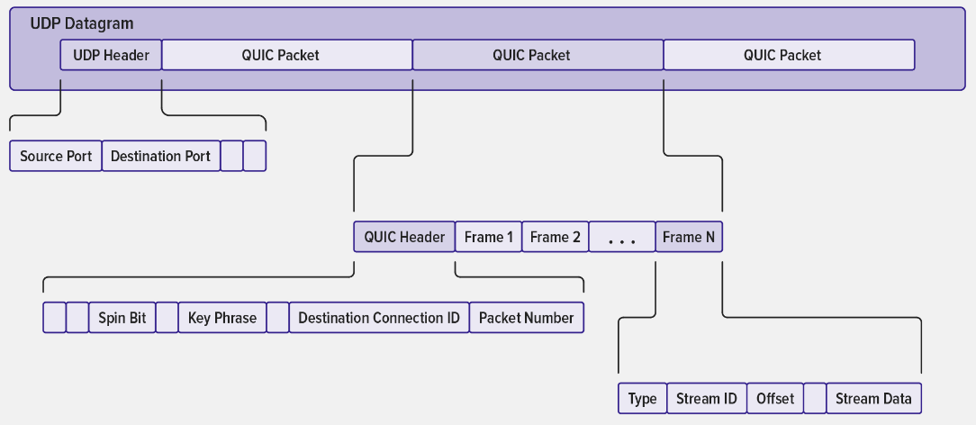
Core (cont.)
Network anatomy of QUIC

Slide 17
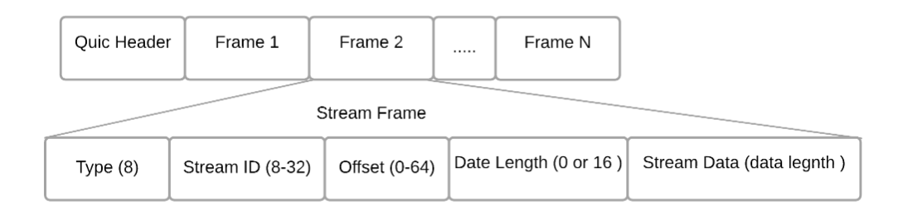
Core (cont.)
QUIC packet format

Slide 18
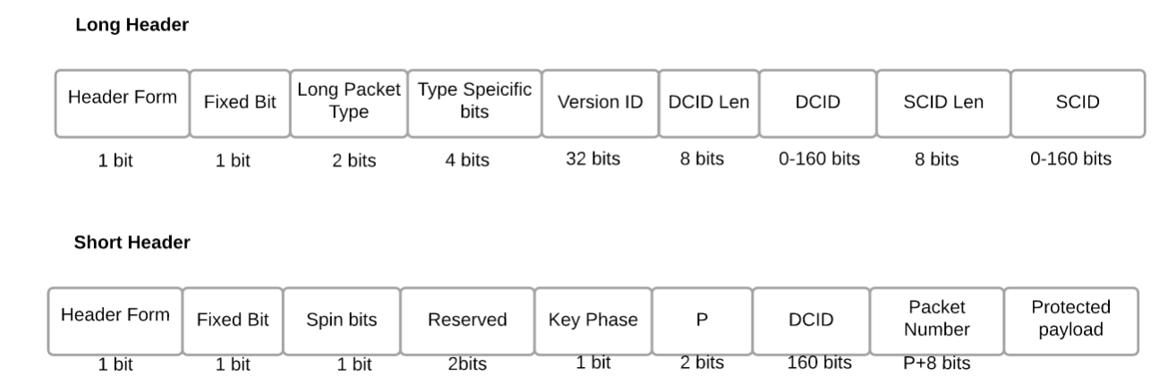
Core (cont.)
QUIC header (IETF QUIC v1) format

Slide 19
Core (cont.)
Connection Establishment
For establishing a transport connection, QUIC combines cryptographic and transport handshake.
In the initial connection, the client doesn't have information about the server.
After the first successful handshake, the client stores the server information so, in any succeeding connection, the client does not require an extra round-trip time (RTT).

Slide 20
Core (cont.)
First-time Connection Establishment
For the first time a client tries to establish a connection with a server.
The client will send an inchoate client hello (CHLO) message to the server to receive a reject (REJ) message.
The REJ message contains the server configuration, authentication certificate, signature for the server certificate, and source-address token.
The source-address token is used to verify the identity of the client in future communications.
The client uses the information provided by the REJ message to construct the complete CHLO message.
Then, the client sends a complete CHLO message that contains a temporary Diffie-Hellman public key for the client .

Slide 21
Core (cont.)
0-RTT connection establishment
After the initial handshake, the client has the initial keys for the connection.
Once the client sends a complete CHLO message to the server, it can start sending data before receiving the Server Hello (SHLO) message.
This is how QUIC achieves 0-RTT.
After the client receives SHLO, the client starts sending data using final keys calculated from the information provided in the SHLO message.

Slide 22
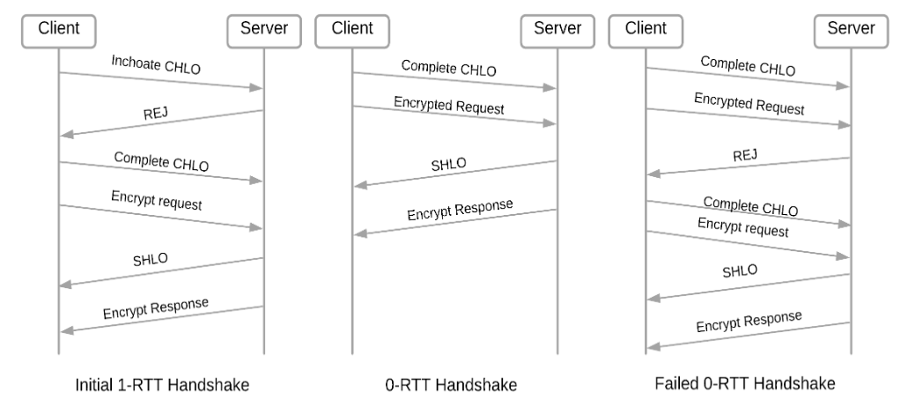
Core (cont.)

Slide 23
Core (cont.)
Connection migration
QUIC allows a connection between a client and a server to remain active even after the client IP or port changes because QUIC uses Connection ID to identify a connection.
After a change happens to the client's network, the client can use the Connection ID previously initialized from the prior connection to initiate a Connection Migration (CM) request to the server using a probing packet (PATH_CHALLENGE).
If the server accepts the Connection Migration request, it starts path validation by sending PATH_CHALLENGE and PATH_RESPONSE frames to confirm that the client's ownership of the new address.
After the path validation, the peers can send and receive data based on the new address.

Slide 24
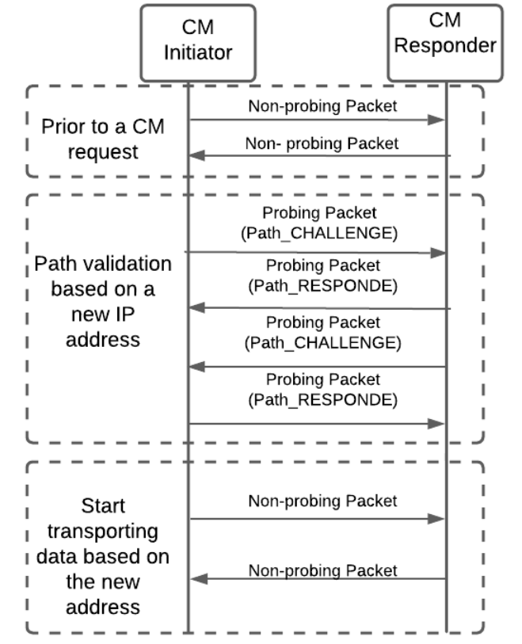
Core (cont.)

Slide 25
Core (cont.)
QUIC Congestion & Recovery:
Estimating RTT
Loss Detection
Congestion Control

Slide 26
Core (cont.)
Estimating RTT
QUIC uses an RTT sample to detect any delay or lost packet in a connection.
An RTT sample is generated by measuring the time between sending a packet and receiving the acknowledgment.
Details are found in https://datatracker.ietf.org/doc/html/rfc9002 (QUIC Loss Detection and Congestion Control)

Slide 27
Core (cont.)
Loss Detection
QUIC uses acknowledgments to discover missing packets.
If a packet is lost, the QUIC transport must either retransmit the data, deliver an updated frame, or trash the frame to recover from the loss.
Loss detection is done separately for each packet number space to avoid head-of-line blocking.

Slide 28
Core (cont.)
Congestion Control
QUIC offers a different congestion management environment than TCP.
QUIC incorporates current loss-recovery algorithms like retransmission timeout (RTO), tail loss probe, Forward RTO-Recovery (F-RTO), and Early Retransmit from the start.

Slide 29
Core (cont.)
STREAM frames encapsulate data sent by an application.
An endpoint uses the Stream ID and Offset fields in STREAM frames to place data in order.
An endpoint could receive data for a stream at the same stream offset multiple times.
Data that has already been received can be discarded; an endpoint MAY treat receipt of different data at the same offset within a stream as a connection error of type PROTOCOL_VIOLATION.

Slide 30
Core (cont.)
Endpoints MUST NOT exceed the limit set by their peer.
An endpoint that receives a STREAM frame with an ID greater than the limit it has sent MUST treat this as a stream error of type STREAM_ID_ERROR.
QUIC does not provide a mechanism for exchanging prioritization information.
QUIC relies on receiving priority information from the application.
A QUIC implementation SHOULD provide ways in which an application can indicate the relative priority of streams.

Slide 31
Core (cont.)
QUIC frames
Value | Type | Value | Type
0x00 | PADDING | 0x11 | MAX_STREAM_DATA
0x01 | PING | 0x12-0x13 | MAX_STREAMS
0x02-0x03 | ACK | 0x14 | DATA_BLOCKED
0x04 | RESET_STREAM | 0x15 | STREAM_DATA_BLOCKED
0x05 | STOP_SENDING | 0x16-0x17 | STREAMS_BLOCKED
0x06 | CRYPTO | 0x18 | NEW_CONNECTION_ID
0x07 | NEW_TOKEN | 0x19 | RETIRE_CONNECTION_ID
0x08-0x0f | STREAM | 0x1a | PATH_CHALLENGE
0x10 | MAX_DATA | 0x1b | PATH_RESPONSE

Slide 32
Core (cont.)
QUIC frames
Value | Type
0x1c-0x1d | CONNECTION_CLOSE
0x1e | HANDSHAKE_DONE
0x1f | IMMEDIATE_ACK
0x30-0x31 | DATAGRAM
0xad | ACK_FREQUENCY
0x15228c00-0x15228c01 | ACK_MP
0x15228c05 | PATH_ABANDON
0x15228c06 | PATH_STATUS
0x15228c07 | PATH_STANDBY
0x15228c08 | PATH_AVAILABLE

Slide 33
Core (cont.)
A PADDING frame (type=0x00) has no semantic value.
Padding can be used to increase an Initial packet to the minimum required size or to provide protection against traffic analysis for protected packets.
Receivers send ACK frames (types 0x02 and 0x03) to inform senders of packets they have received and processed.

Slide 34
Core (cont.)
Endpoints can use PING frames (type=0x01) to verify that their peers are still alive or to check reachability to the peer.
The receiver of a PING frame simply needs to acknowledge the packet containing this frame.
The PING frame can be used to keep a connection alive when an application or application protocol wishes to prevent the connection from timing out.

Slide 35
Core (cont.)
RST_STREAM (type=0x04) terminates one direction of a stream abruptly.
On receipt of an RST_STREAM frame, an endpoint will tear down state for the matching stream and ignore further data arriving on that stream.
For a bidirectional stream, RST_STREAM has no effect on data flow in the opposite direction.
Both endpoints MUST maintain state for the stream in the unterminated direction until that direction enters a terminal state, or either side sends CONNECTION_CLOSE or APPLICATION_CLOSE.

Slide 36
Core (cont.)
An endpoint uses a STOP_SENDING frame (type=0x05) to communicate that incoming data is being discarded on receipt per application request.
STOP_SENDING requests that a peer cease transmission on a stream.
Receiving a STOP_SENDING frame for a locally initiated stream that has not yet been created MUST be treated as a connection error of type STREAM_STATE_ERROR.
An endpoint that receives a STOP_SENDING frame for a receive-only stream MUST terminate the connection with error STREAM_STATE_ERROR.

Slide 37
Core (cont.)
QUIC relies on a combined cryptographic and transport handshake to minimize connection establishment latency.
QUIC uses the CRYPTO frame (type=0x06) to transmit the cryptographic handshake.
QUIC provides reliable, ordered delivery of the cryptographic handshake data.

Slide 38
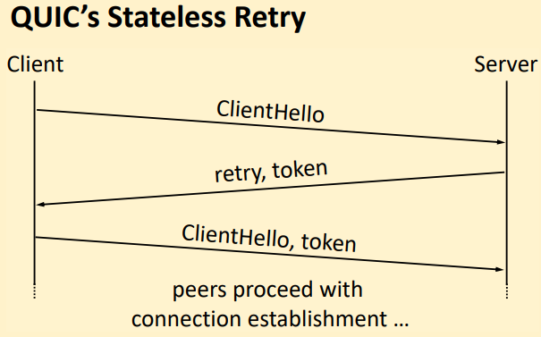
Core (cont.)
A server sends a NEW_TOKEN frame (type=0x07) to provide the client with a token to send in the header of an Initial packet for a future connection.
An initial QUIC handshake requires two round-trips.
The first round-trip accounts for a challenge-response mechanism known as stateless retry. This mechanism validates the claimed source address to prevent IP spoofing attacks. The second round-trip is used to conduct the cryptographic connection establishment.

Slide 39
Core (cont.)
A client might receive multiple NEW_TOKEN frames that contain the same token value if packets containing the frame are incorrectly determined to be lost.
Clients MUST NOT send NEW_TOKEN frames.
A server MUST treat receipt of a NEW_TOKEN frame as a connection error of type PROTOCOL_VIOLATION.

Slide 40
Core (cont.)
A MAX_DATA frame (type=0x10) is used in flow control to inform the peer of the maximum amount of data that can be sent on the connection as a whole.
A MAX_STREAM_DATA frame (type=0x11) is used in flow control to inform a peer of the maximum amount of data that can be sent on a stream.
A MAX_STREAMS frame (type=0x12 or 0x13) informs the peer of the cumulative number of streams of a given type it is permitted to open.

Slide 41
Core (cont.)
A sender SHOULD send a STREAMS_BLOCKED frame (type=0x16 or 0x17) when it wishes to open a stream but is unable to do so due to the maximum stream limit set by its peer.
A STREAMS_BLOCKED frame does not open the stream but informs the peer that a new stream was needed, and the stream limit prevented the creation of the stream.

Slide 42
Core (cont.)
The server uses a HANDSHAKE_DONE frame (type=0x1e) to signal confirmation of the handshake to the client.
An endpoint sends a NEW_CONNECTION_ID frame (type=0x18) to provide its peer with alternative connection IDs that can be used to break linkability when migrating connections.
An endpoint sends a RETIRE_CONNECTION_ID frame (type=0x19) to indicate that it will no longer use a connection ID that was issued by its peer.
An endpoint sends a CONNECTION_CLOSE frame (type=0x1c or 0x1d) to notify its peer that the connection is being closed.

Slide 43
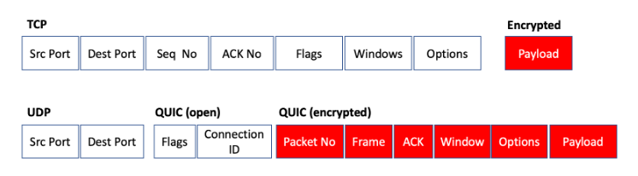
Core (cont.)
QUIC encryption is performed on the UDP payload, so once the TLS handshake is complete, very little of the subsequent QUIC packet exchange is in the clear.
QUIC packet consists of the connection ID, allowing the receiver to associate the packet with an endpoint without decrypting the entire packet.

Slide 44
Core (cont.)
HTTP 3 frames
Frame | Control Stream | Request Stream | Push Stream
DATA | No | Yes | Yes
HEADERS | No | Yes | Yes
CANCEL_PUSH | Yes | No | No
SETTINGS | Yes | No | No
PUSH_PROMISE | No | Yes | No
GOAWAY | Yes | No | No
MAX_PUSH_ID | Yes | No | No

Slide 45
HTTP/2 vs HTTP/3
Option | HTTP/2 | HTTP/3
Transport Layer protocol | TCP | QUIC, over UDP
Multiplexing & head-of-line(HOL) | HOL issues for multiplexed streams due to limitations in byte stream abstraction | No HOL, due to UDP out-of-order delivery
Error handling | Fewer error handling capabilities | Enhanced error handling due to QUIC
TLS encryption | TLS is optional | TLS is embedded in QUIC and by default in HTTP/3
Header compression | HPACK | QPACK
Connection migration | Not supported | Support seamless connection migration via connection IDs

Slide 46
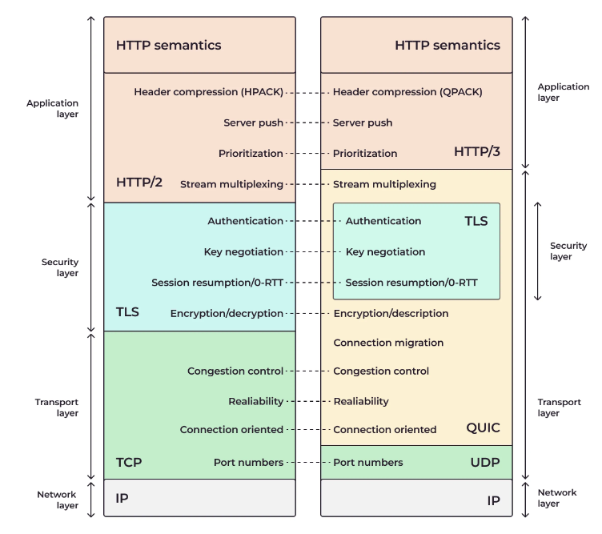
HTTP/2 vs HTTP/3 (cont.)

Slide 47
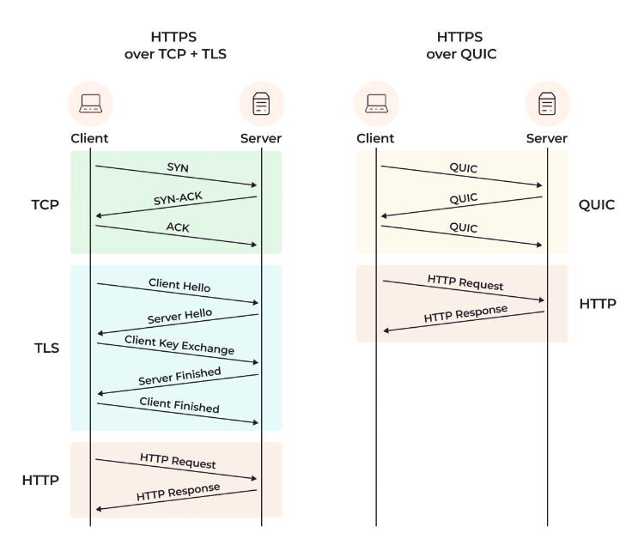
HTTP/2 vs HTTP/3 (cont.)

Slide 48
HTTP/2 vs HTTP/3 (cont.)
HTTP/2 uses HPACK for header or field compression, while HTTP/3 uses QPACK.
Although both HPACK and QPACK are efficient, they work differently, and while HPACK is prone to HOL, QPACK is not.
Both HTTP/2 and HTTP/3 support server push.
In HTTP/3, clients can set the number of acceptable pushes via the push stream ID to reduce wasted bandwidth.
Both protocols offer TLS encryption. In HTTP/2, TLS is optional, and the TLS encryption is via the common TLS 1.2 and TLS 1.3 protocols.
In HTTP/3, TLS encryption is provided by default via QUIC’s key exchange mechanism, universally reducing the risk of eavesdropping, data tampering, and other security threats.

Slide 49
HTTP/2 vs HTTP/3 (cont.)
Session resumption involves reusing parameters used in previous exchanges without reinitiating a full handshake.
In HTTP/2, session resumption is implemented using the TLS session tickets mechanism, where at least two rounds of handshakes—TCP & TLS—are required before reconnect.
On the other hand, HTTP/3 leverages QUIC’s 0-RTT (zero round trip time resumption) feature, which enables clients to send encrypted data in the first packet of the handshake, allowing for faster resumption of previous sessions.

Slide 50
Conclusions
Pros:
Low latency
High throughput
High reliability

Slide 51

Bibliography
https://en.wikipedia.org/wiki/HTTP/3
https://gcore.com/learning/what-is-http-3
https://www.rfc-editor.org/rfc/rfc9000.html
https://datatracker.ietf.org/doc/html/rfc9114
https://blog.apnic.net/2019/03/04/a-quick-look-at-quic/
https://www.cse.wustl.edu/~jain/cse570-21/ftp/quic/index.html

